Slide 1

DATA SCIENCE PROJECT
Predicting Customer Buying Behavior

Slide 2
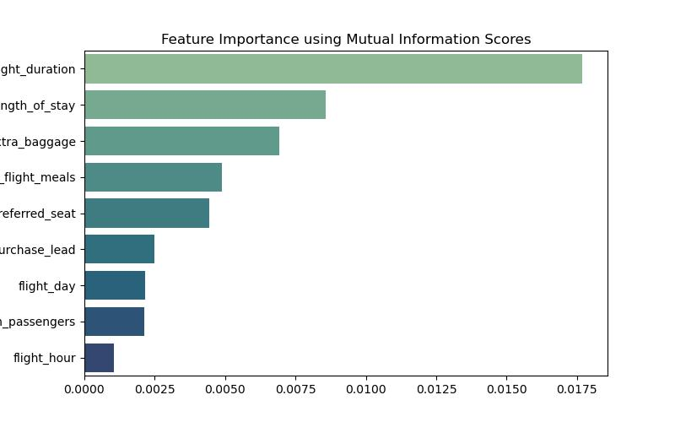
Predictive Model To Understand Factors That Influence Buying Behavior
Top 5 features which influence
Customer buying behavior:
Flight Duration
Length of Stay
Extra Baggage
Flight Meals
Referred Seat
We have trained the data set with Random Forest Classifier model and received
Training Accuracy: 99.95
Validation Accuracy: 84.62
Presentation created by ABHAY PANDEY
On 21st May 2025

